Slide 1
question1
Why active fund mangers are bad choices

Slide 2
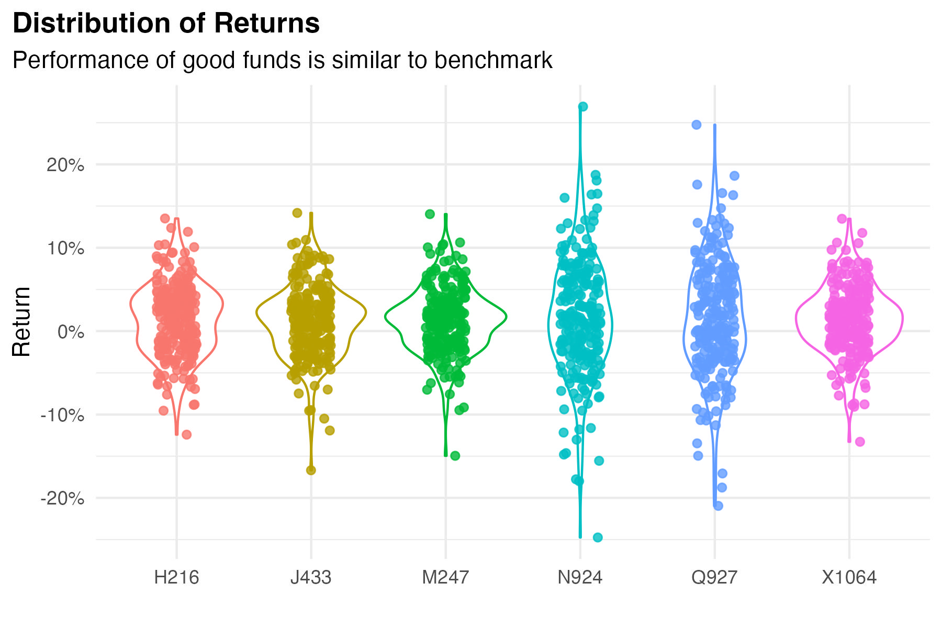
Return distribution

Slide 3
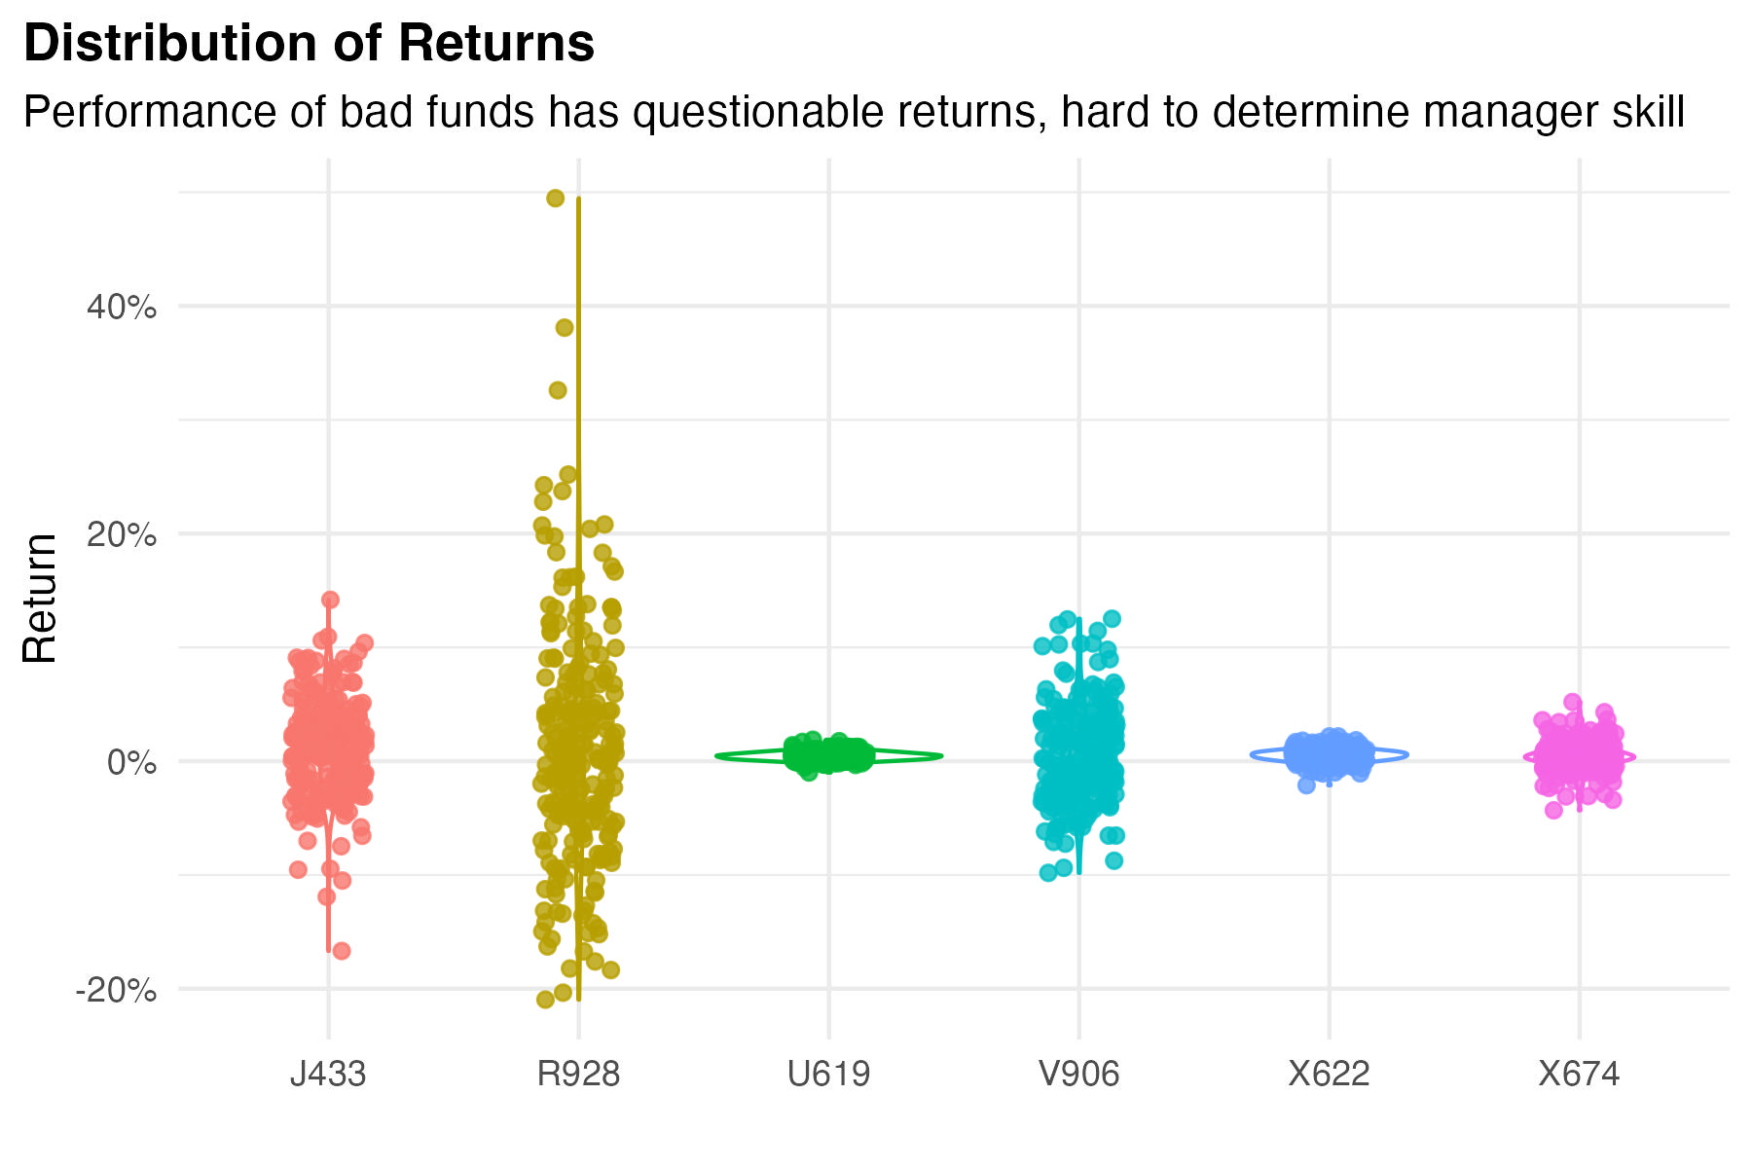
Return distribution

Slide 4
Life-Time ROI (Good Manager)

